Slide 1
Convolution & Integral Image

Slide 2

2D Convolution
Threads to only copy input data to shared memory
with halo part
Threads to also do filtering
Output
p.252 in
__global__ void filter_1D (float *in, float *out){
__shared__ float smem[BDIM + 2*RADIUS];
//index to global memory
int idx = threadIdx.x + blockIdx.x*blockDim.x;
// index to shared memory
int sidx = threadIdx.x+RADIUS;
// read data from global memory into shared memory
smem[sidx] = in[idx];
// read halo part to shared memory
if (threadIdx.x < RADIUS){
smem[sidx-RADIUS] = in[idx-RADIUS];
smem[sidx+BDIM] = in[idx+BDIM];
}
_synthreads();
float tmp = 0.0f;
#pragma unroll
for (int i=1; i<=RADIUS; i++){
tmp += coef[i] * (smem[sidx+i]-smem[sidx-i]);
}
out[idx] = tmp;
}
Input

Slide 3
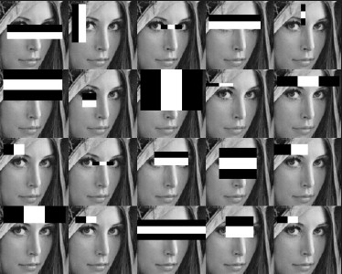
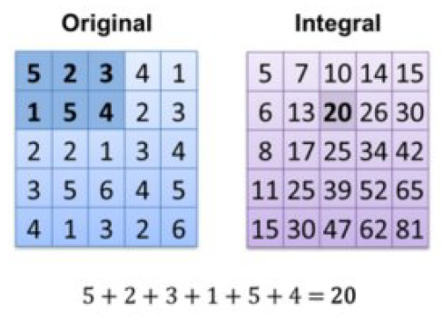
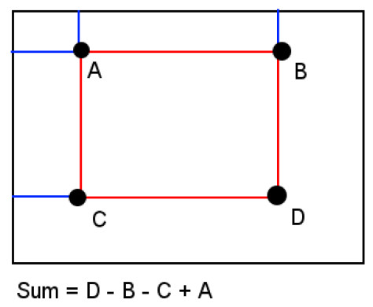
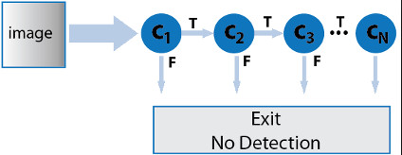
Integral Image in Viola-Jones
Be aware: inclusive vs. exclusive boundaries !
https://www.mathworks.com/help/vision/ref/vision.cascadeobjectdetector-system-object.html
Vinay Gangadhar, Sharmila Shridhar, Ram Sai Manoj Bamdhamravuri, « An Efficient GPGPU Implementation of Viola-Jones Classifier Based Face Detection Algorithm», 2015. https://pdfs.semanticscholar.org/df51/d088125c96c53bfb23c2fdfdc7977b58dc79.pdf

Slide 4
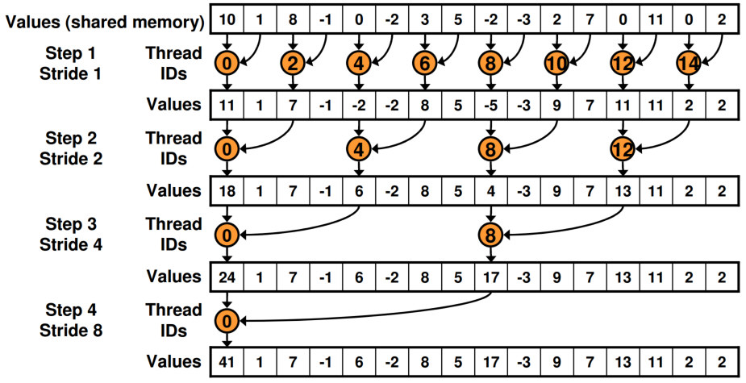
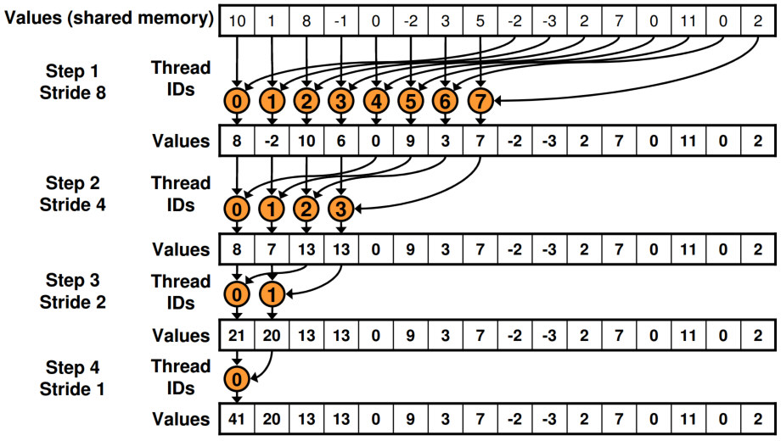
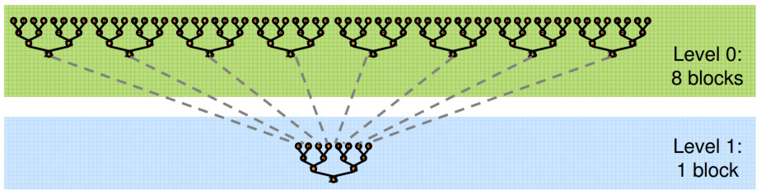
Parallel reduction for the sum of all pixels
Exercises:
Write code for these two cases
Which speed-up is expected?
Foresee last steps on CPU
On GPU
On CPU

Slide 5
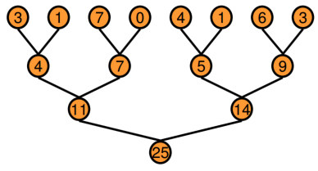
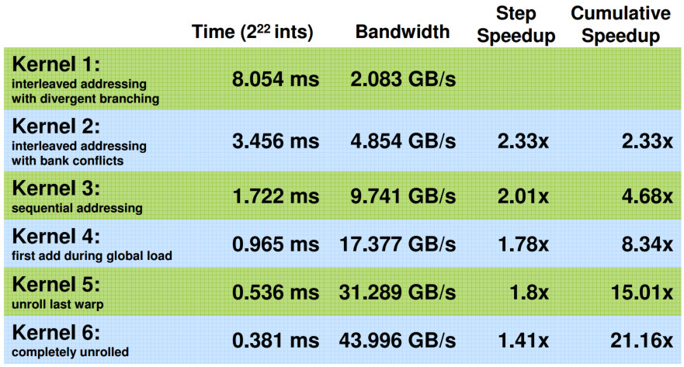
Parallel reduction
Calculate the sum of a pool of elements in parallel
Will be reused in the optimization session

Slide 6
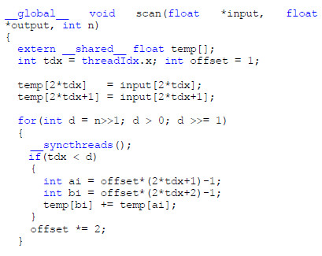
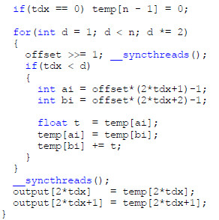
Exclusive scan Integral Image: 4 elements
1
3
3
10
1
3
3
0
1
3
3
7
1
0
3
3
1
2
3
4
0
1
3
6
10
Phase 1
Phase 2
For the inclusive scan
Bilgic B, B K P Horn, and I Masaki, “Efficient Integral Image Computation on the GPU,” pp. 528–533, IEEE, 2010. http://dspace.mit.edu/handle/1721.1/71883 ]

Slide 7
Exclusive scan Integral Image: 8 elements
1
3
3
10
5
11
7
36
1
3
3
10
5
11
7
0
1
3
3
10
5
11
7
26
1
3
3
0
5
11
7
10
1
3
3
7
5
11
7
15
1
0
3
3
5
10
7
21
1
2
3
4
5
6
7
8
0
1
3
6
10
15
21
28
36
Phase 1
Phase 2

Slide 8
Exclusive scan Integral Image: 16 elements – phase 1
1
3
3
10
5
11
7
36
9
19
11
42
13
27
15
136
1
3
3
10
5
11
7
36
9
19
11
42
13
27
15
100
1
3
3
10
5
11
7
26
9
19
11
42
13
27
15
58
1
3
3
7
5
11
7
15
9
19
11
23
13
27
15
31
1
2
3
4
5
6
7
8
9
10
11
12
13
14
15
16

Slide 9
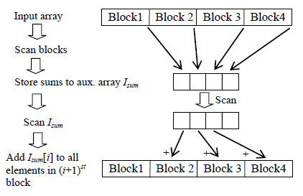
Exclusive scan Integral Image: 16 elements – phase 2
1
3
3
10
5
11
7
36
9
19
11
42
13
27
15
136
1
3
3
10
5
11
7
36
9
19
11
42
13
27
15
0
With many elements:
1
3
3
10
5
11
7
0
9
19
11
42
13
27
15
36
1
3
3
0
5
11
7
10
9
19
11
36
13
27
15
78
1
0
3
3
5
10
7
21
9
36
11
55
13
78
15
105
0
1
3
6
10
15
21
28
36
45
55
66
78
91
105
120
136

Slide 10
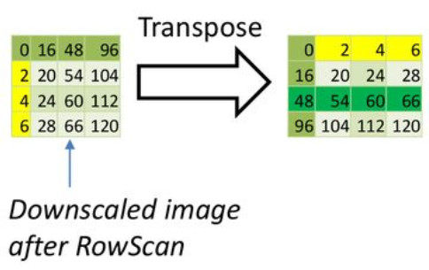
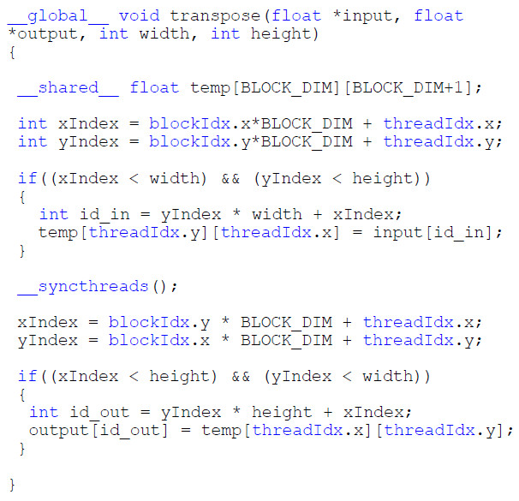
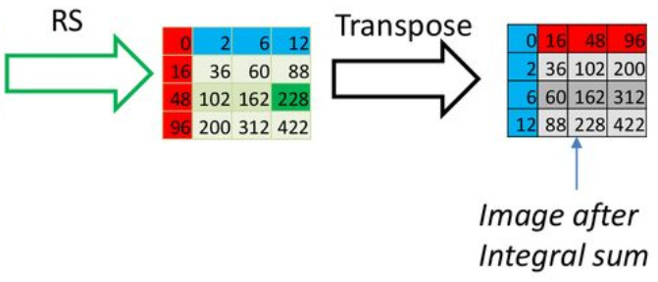
Integral Image: use the transpose
An efficient GPGPU implementation of Viola-Jones Classifier based Face detection algortihm
Sharmila Shridhar, Vinay Gangadhar, Ram Sai Manoj, ECE 759 Project presentation, Fall 2015, University of Wisconsin - Madison
https://slideplayer.com/slide/14224854/

Slide 11
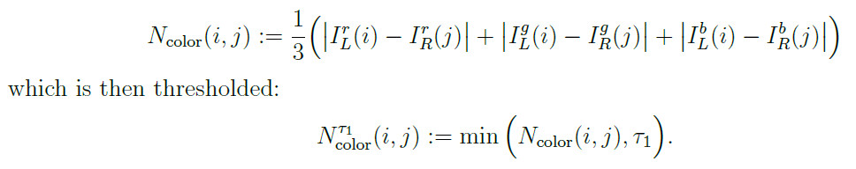
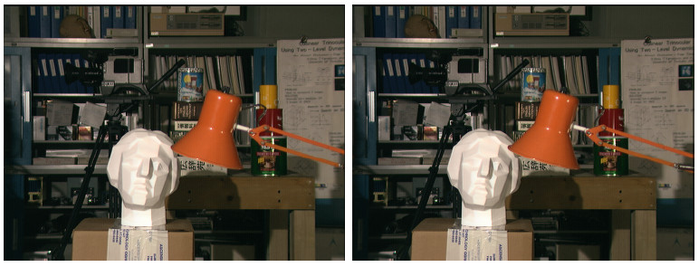
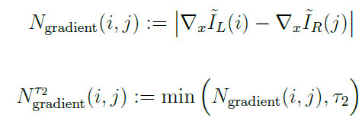
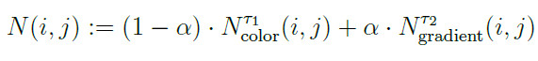
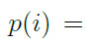
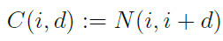
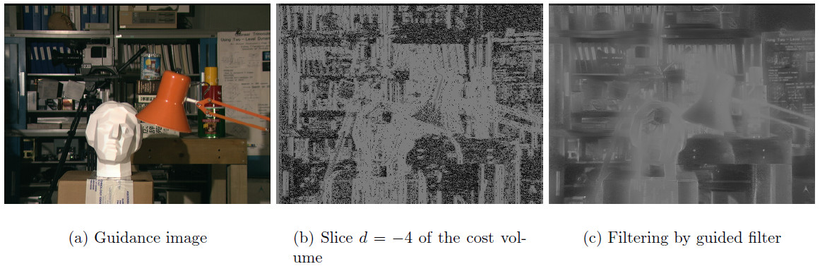
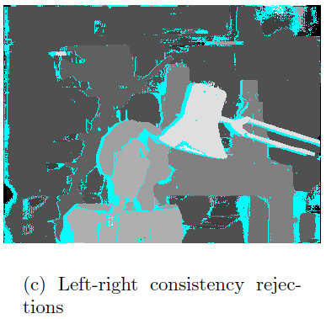
Stereo matching project
d
Left
Right
Allowed to use the luminance only
d
(d)
Pauline Tan, Pascal Monasse, « Stereo Disparity through Cost Aggregation with Guided Filter ,» Image Processing OnLine, Oct. 2014, http://www.ipol.im/pub/art/2014/78/?utm_source=doi

Slide 12
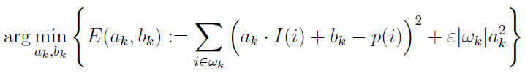
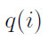
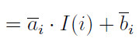
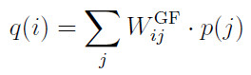
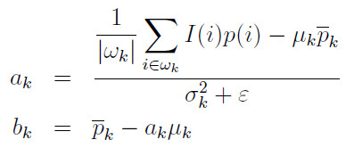
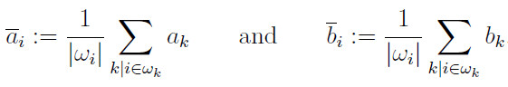
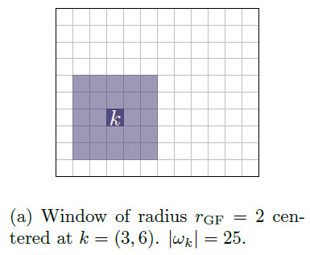
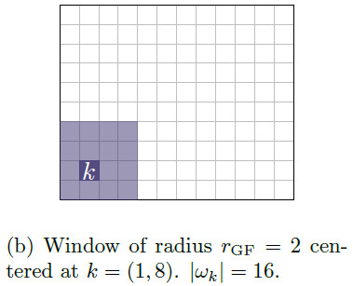
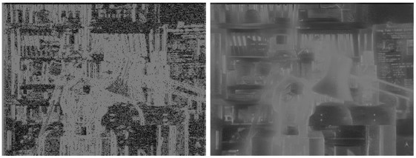
Guided Filter maths
I(i)
= guidance image
= Left
p(i)
q(i)
p(i)
q(i)

Slide 13
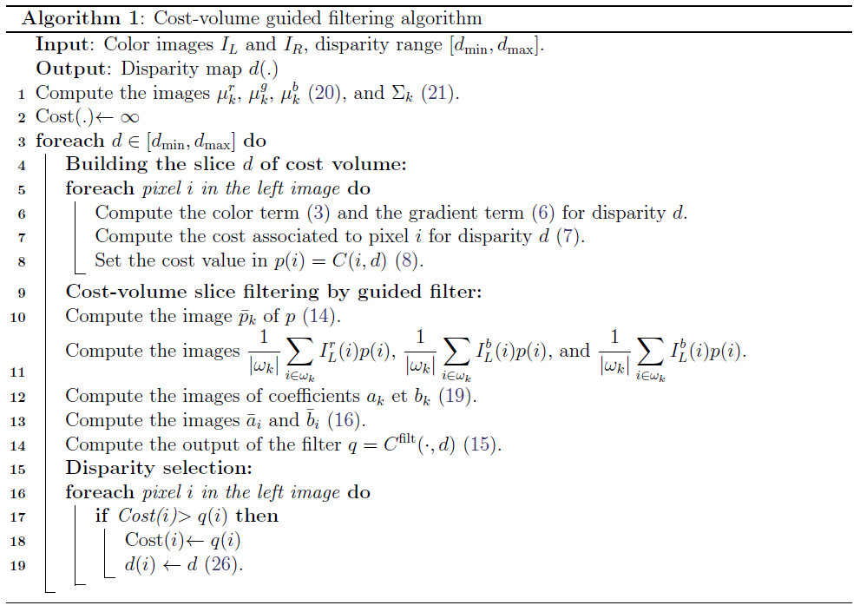
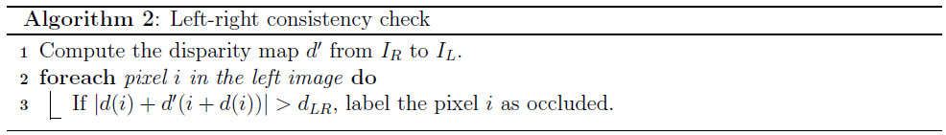
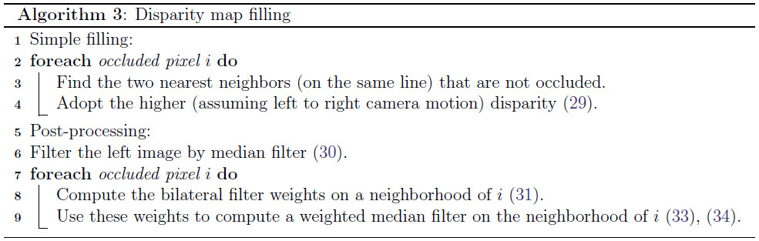
Follow the algorithms well

Slide 14
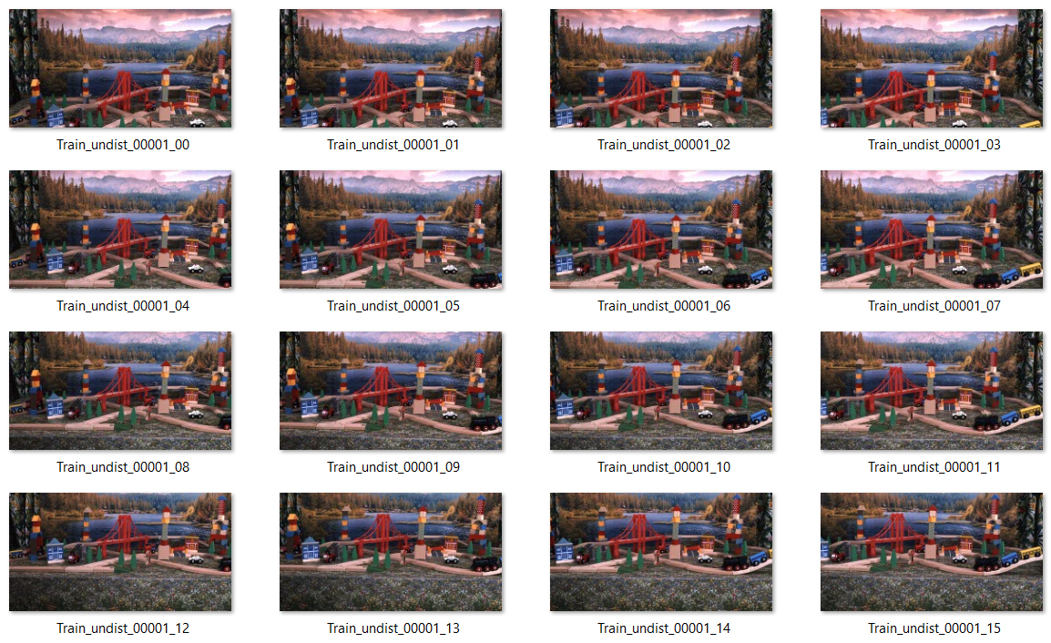
Use big images with many time frames
Frame number
Position number

Slide 15
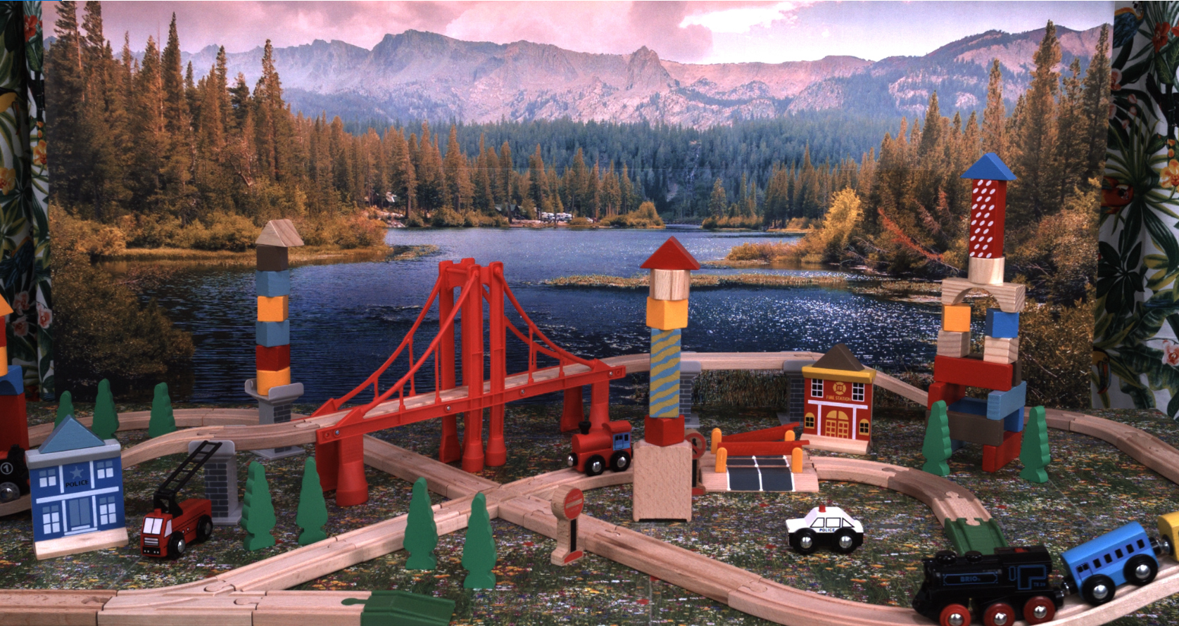

Slide 16
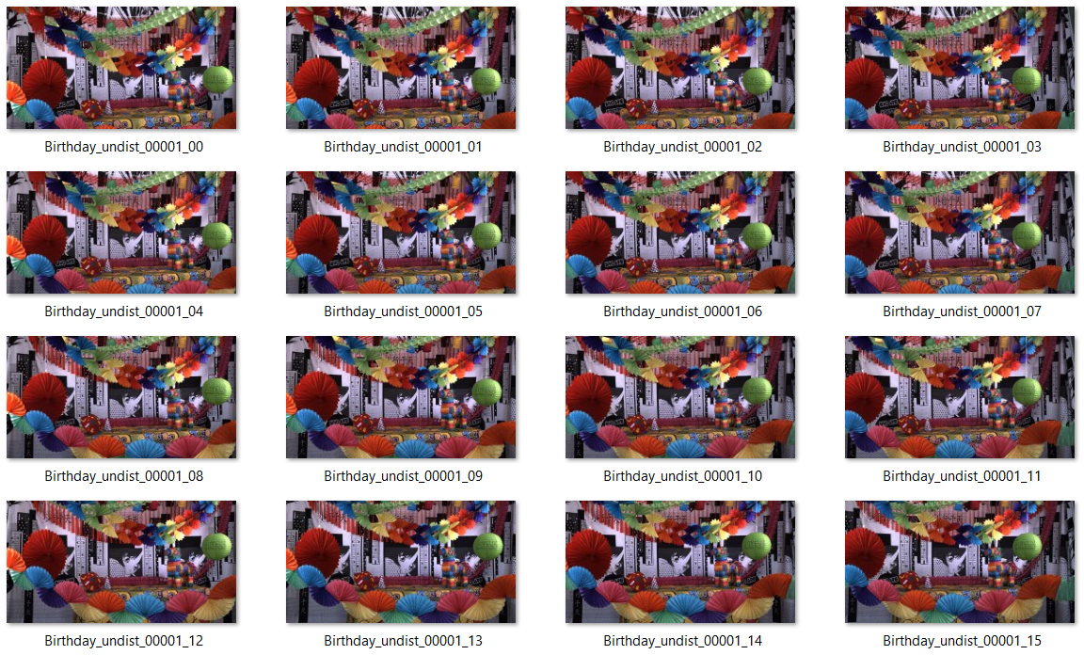

Slide 17
